Slide 1


Mobile App Training

Slide 2
Mobile App Training
Training Overview
Install and Login
Alerts: Send / Receive / Respond
Secure Chat
Polls: Send / Respond / Review
Assigned Tasks: Activate / Complete / Monitor
*The content within this overview is generated from a demo environment for instructional purposes. Users, groups, Incident Types, Templates, etc. may be different from what you see on your own device.

Slide 3
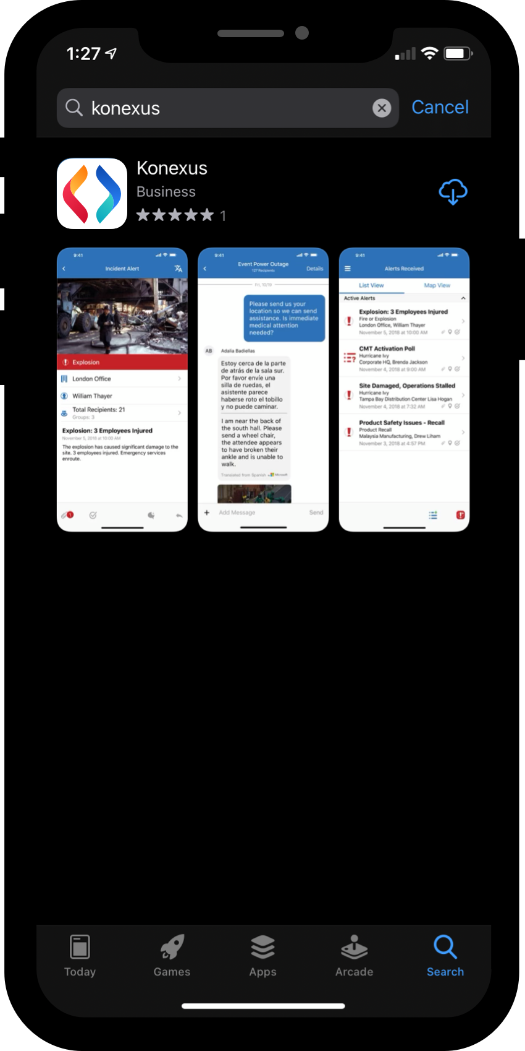
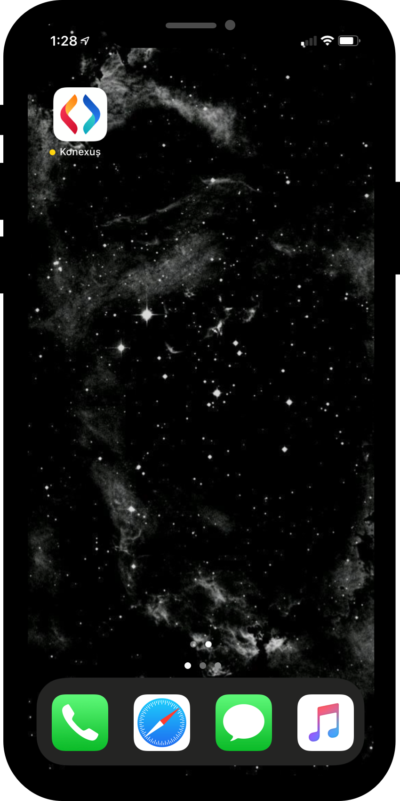
Install and Login
Search either the Apple App Store or the Google Play Store for KONEXUS
Select and download the app titled KONEXUS and install.
After the app is installed, select it from your home screen

Slide 4
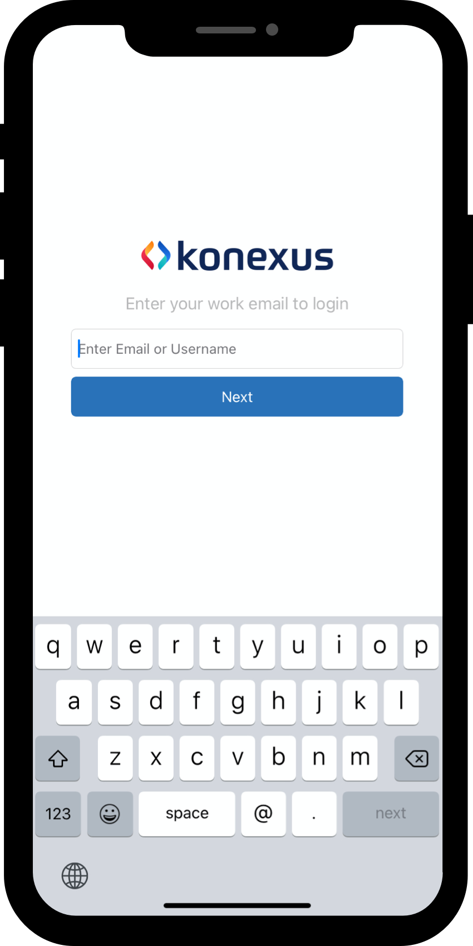
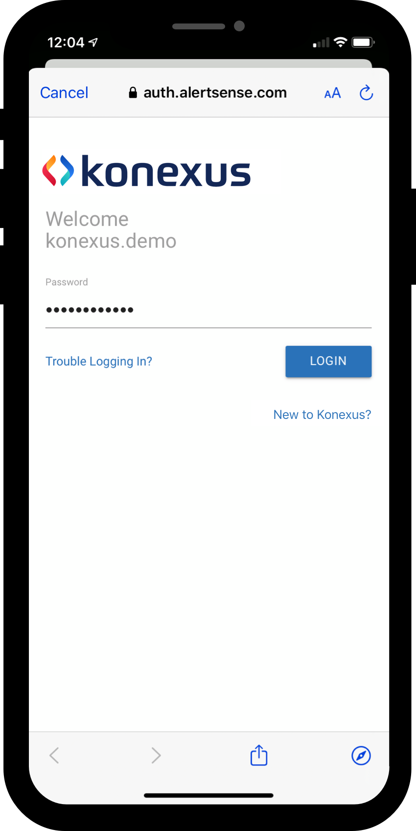
Install and Login
After Opening the app, you will be prompted to login
Enter your work email and tap next to be taken to the password screen.
On the password screen click New to Konexus.
Enter your email on the next screen to send the password creation email.
Follow the instructions in the email that you received.
Repeat steps one and 2 and then enter your new password

Slide 5
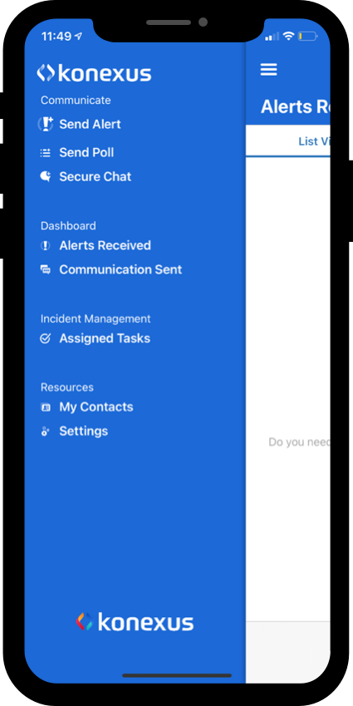
Alerts
Send an Alert
From the Drawer Menu, select Send Alert to start the Alert Creation process.

Slide 6
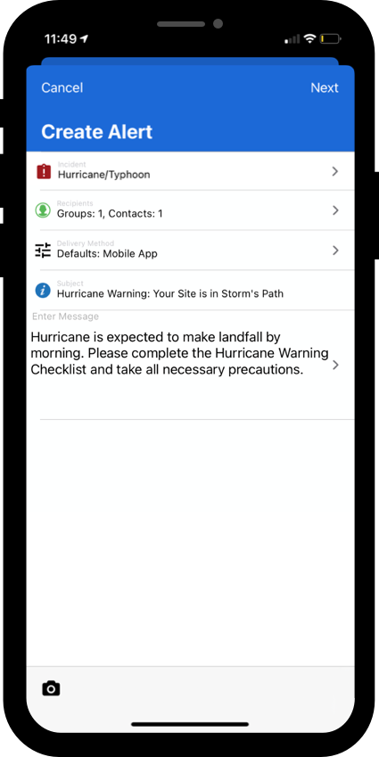
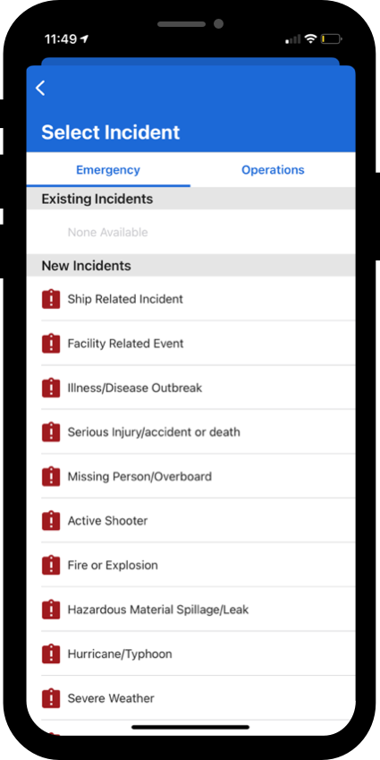
Alerts: send
Select an Incident
Select the Select Incident field
Select the incident that best fits the current situation
Optionally, users can select a template to pre-populate fields from the selected template
  Not all users will have access to select a template

Slide 7
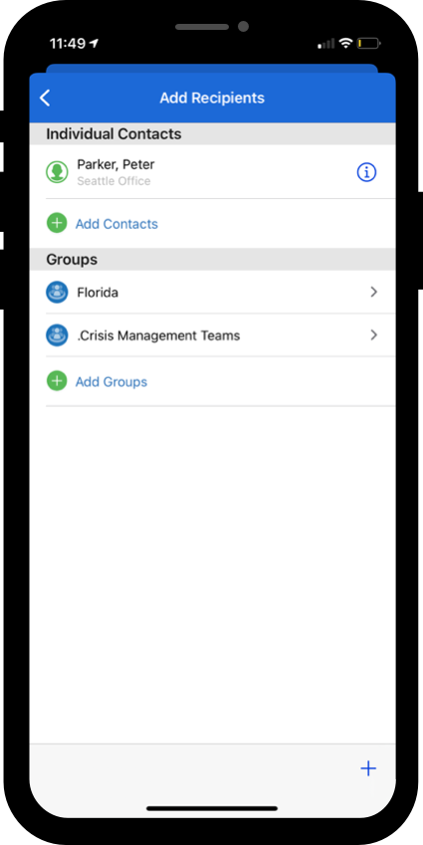
Alerts:
Send
Recipient Selection
Select the Select Recipients field
  Many users may have auto-populated recipients based on their role or the incident type that they selected.
  Users can add to the pre-populated groups if desired
  Pre-populated groups cannot be removed
Tap the back arrow to return the the create alert form

Slide 8
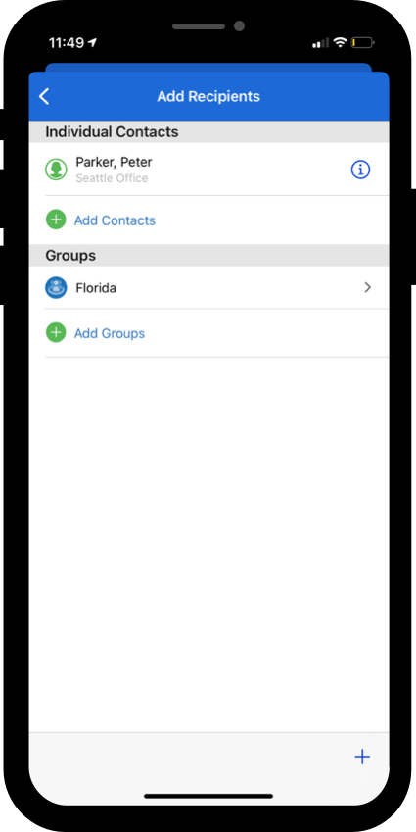
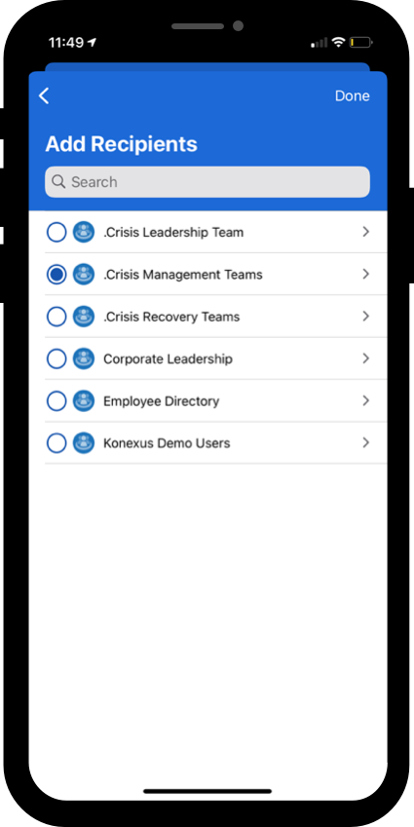
Alerts:
Send
Recipient Selection: Adding Recipients
Adding Groups and Contacts are a similar process, the most common use case is adding recipients by group
Add a Group
  Select Add Groups
  Navigate the group structure to select your desired group or select from a top-level group
  Click Done

Slide 9
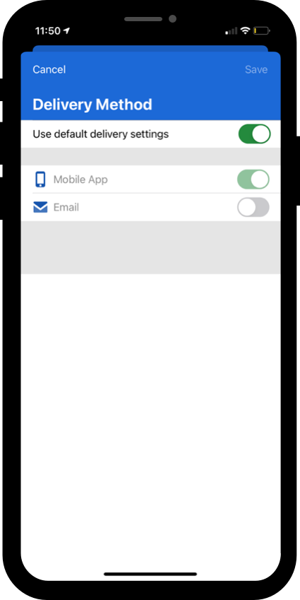
Alerts:
Send
Delivery Methods
Users with the appropriate permissions can modify the channels their alert will be sent through. (mobile app, email, etc.)
Select the Delivery Methods field
Toggle the Use default delivery settings options to enable editing
Enable or disabled the different channels
Click Save

Slide 10
Alerts:
Send
Enter Subject and Message
Select the Subject field and type in your subject.
Select the Message field to enter the message text editor.
  Messages can either be typed using the keyboard or dictated using the microphone.

Slide 11
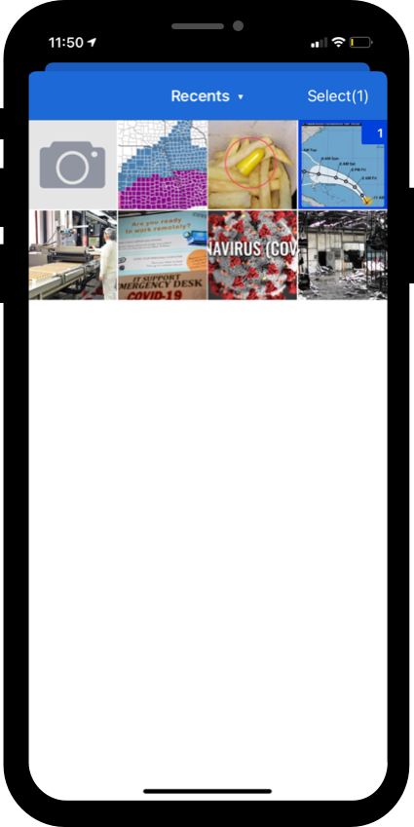
Alerts: send
Optional: Add Images or Videos
To add images, tap the icon in the bottom left corner on the toolbar
  Users can add images that are saved on their device or they can add a new image by selecting the camera icon on the screen
Tap Select in the top right corner to add the selected images or videos to the alert.

Slide 12
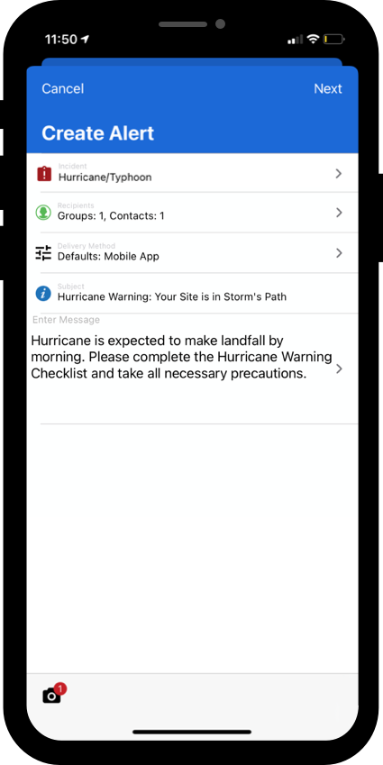
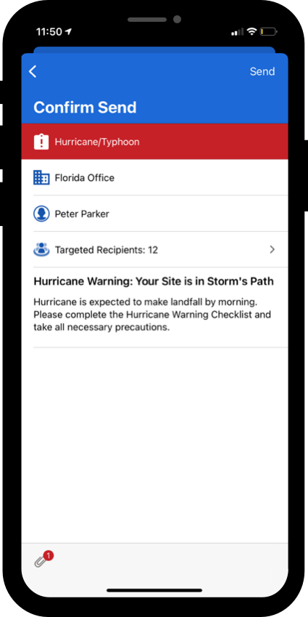
Alerts:
Send
Confirm and Send
Preview the alert form and tap Next
Preview the recipient view and tap Send to send the alert
  Users can tap the back icon in the top left to edit the alert at anytime prior to sending

Slide 13
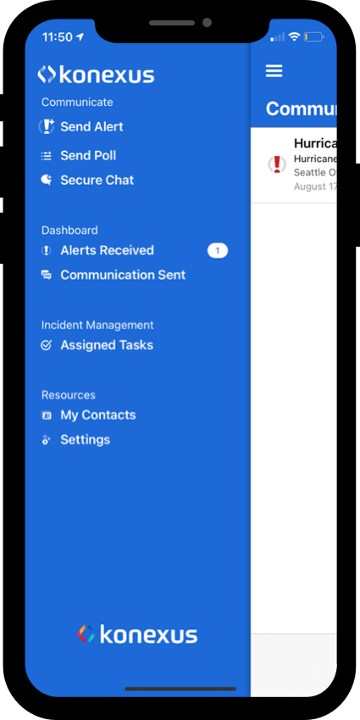
Alerts:
Respond
View Alerts Received
Select Alerts Received to view all the alerts/polls that have been sent to you.

Slide 14
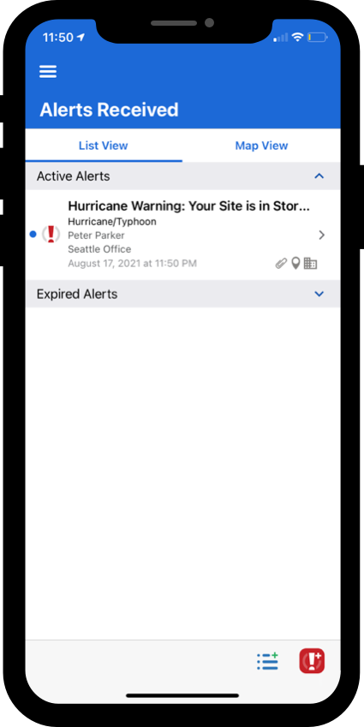
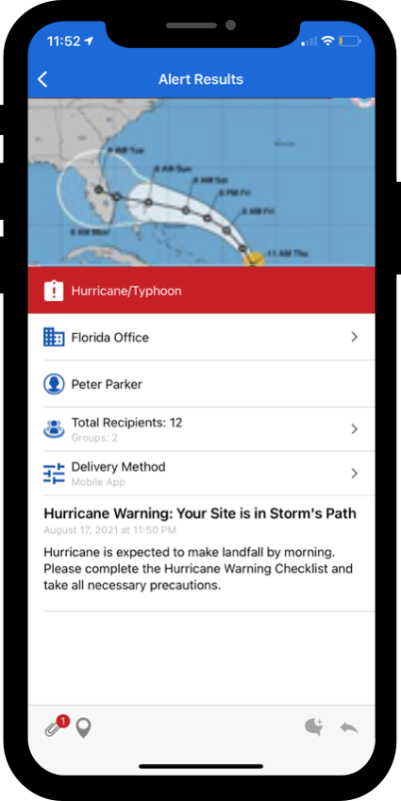





Alerts:
Receive
View Alerts Received
Select Alerts Received from the app drawer menu
Select the desired alert/poll
View the details
Toolbar items
Tap to see all attachments
Tap to review location
Tap to review the severity assessment
Tap to reply/fwd
Tap to initiate a chat from the alert recipients

Slide 15
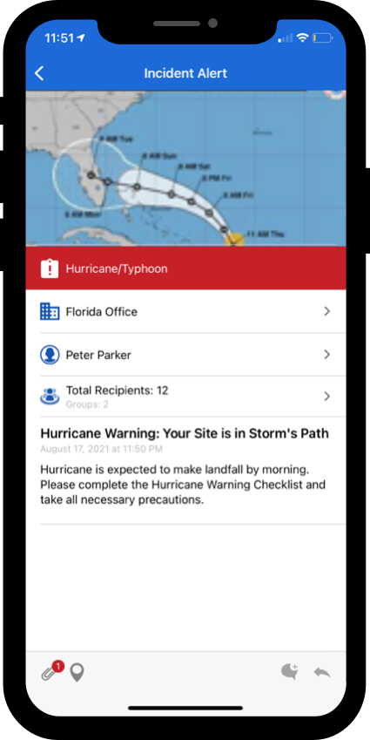
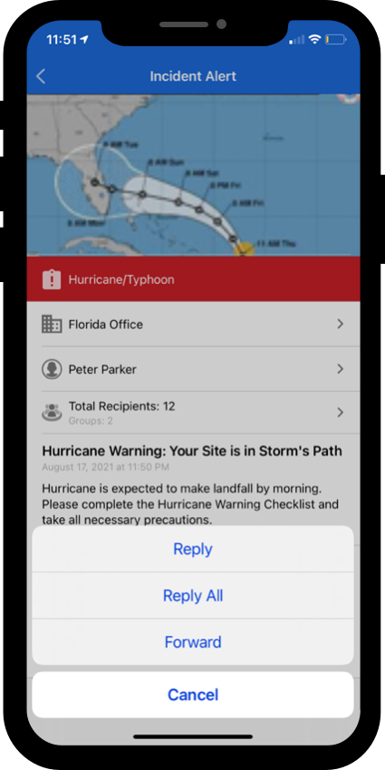
Alerts:
Respond
Initiate a Reply or Forward
Select the icon in the bottom toolbar and select either Reply, Reply All, or Forward
Complete the create alert form when prompted

Slide 16
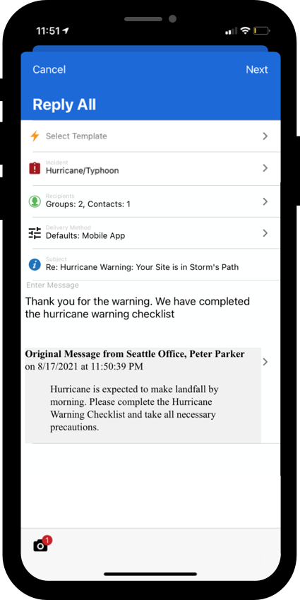
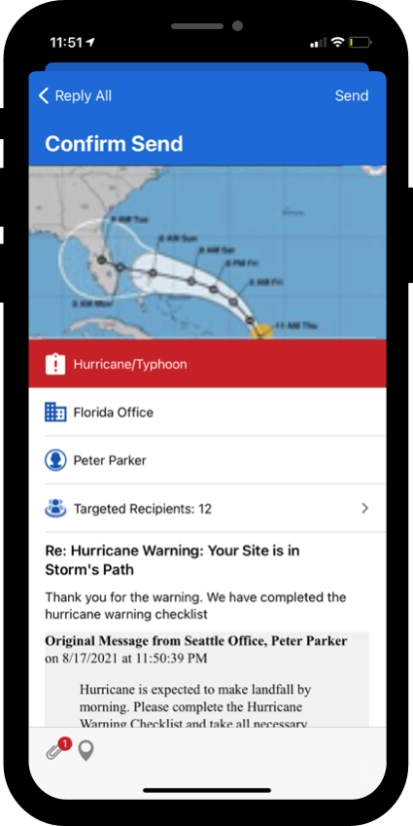
Alerts:
Respond
Send Reply or Forward
Complete the create alert form when prompted
Incident, Recipients, Severity Assessment, and Subject are pre-populated from the original alert but can be edited.
Complete the message, confirm, and send.

Slide 17
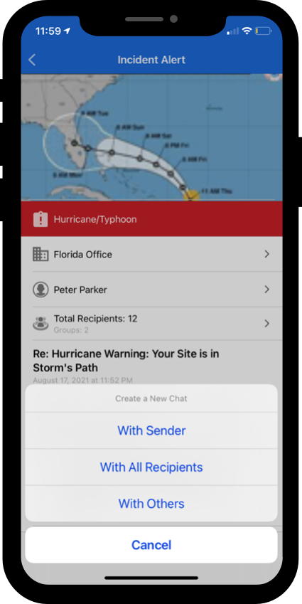
Alerts:
Respond - Chat
Initiate a Chat from an Alert
Select Alerts Received from the app drawer menu
Select the desired alert/poll
Select the icon in the bottom toolbar and select either Chat with Sender, Chat with All Recipients, or Chat with Others
Complete the Create Chat Process

Slide 18
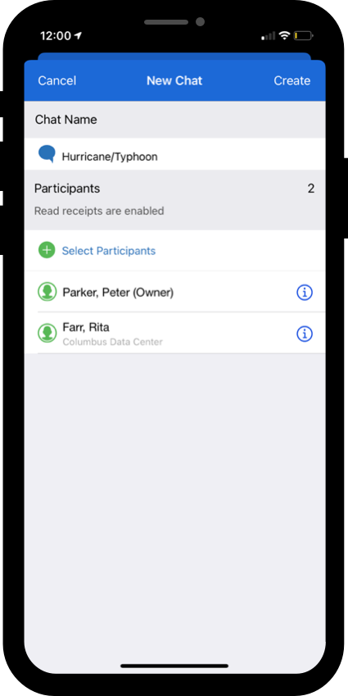
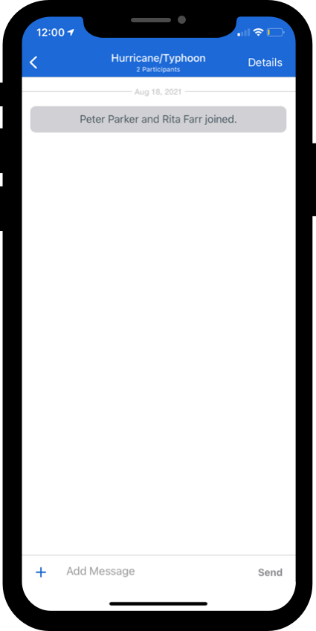
Alerts:
Respond - chat
Create a Secure Chat from an Alert
Review a Chat Name
Review Recipients
Confirm the details and tap Create in the top right corner
Start messaging
  By tapping the + icon users can share their location, images, and videos.

Slide 19
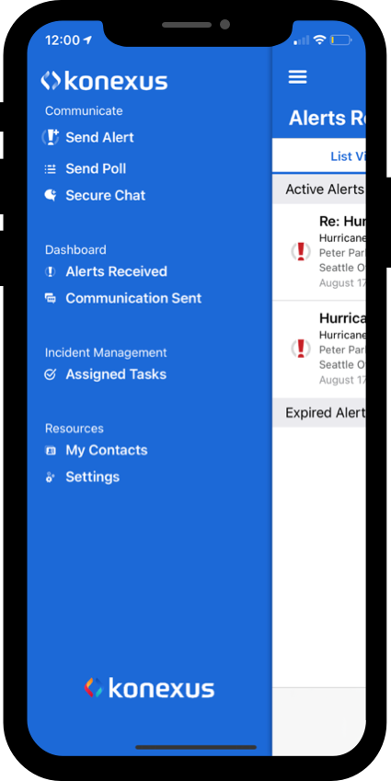
Alerts:
Review
View Communication Sent
Select Communication Sent from the app drawer menu
Select the desired alert/poll
View the details
Toolbar items
Tap to see all attachments
Tap to review location
Tap to review the severity assessment
Tap to reply/fwd
Tap to initiate a chat from the alert recipients

Slide 20
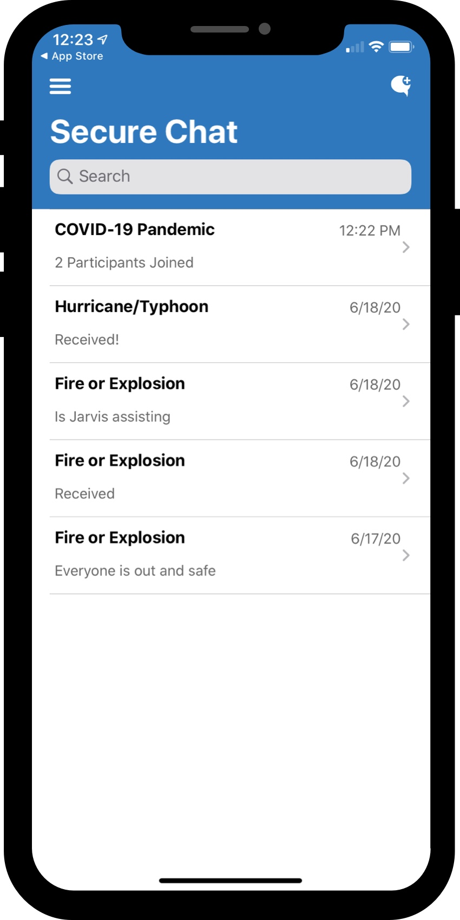
Secure Chat
Create a Secure
From the app drawer menu, select Secure Chat.
Tap the icon in the top left to create a new chat conversation

Slide 21
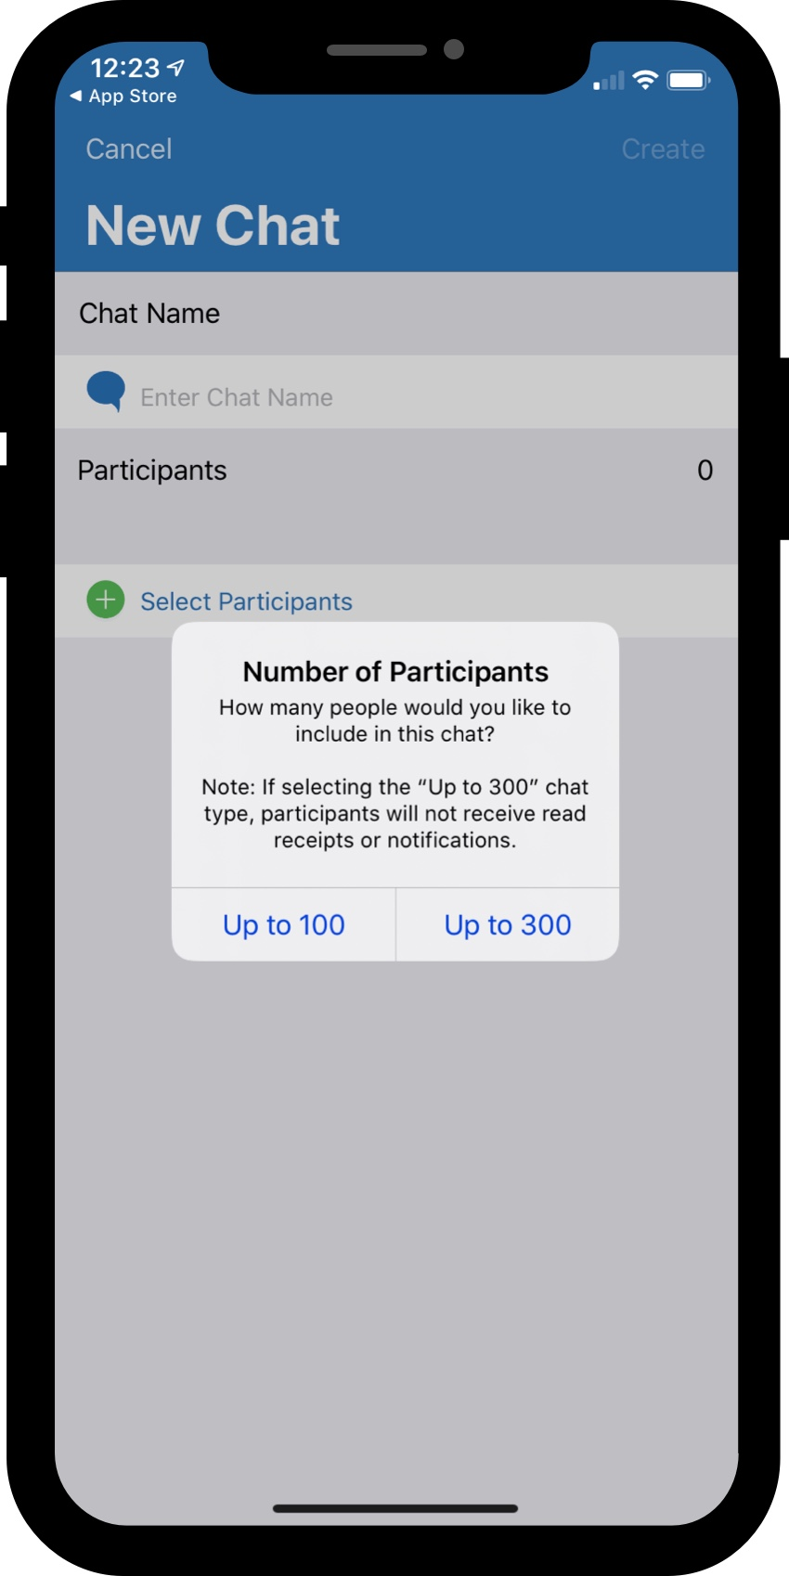
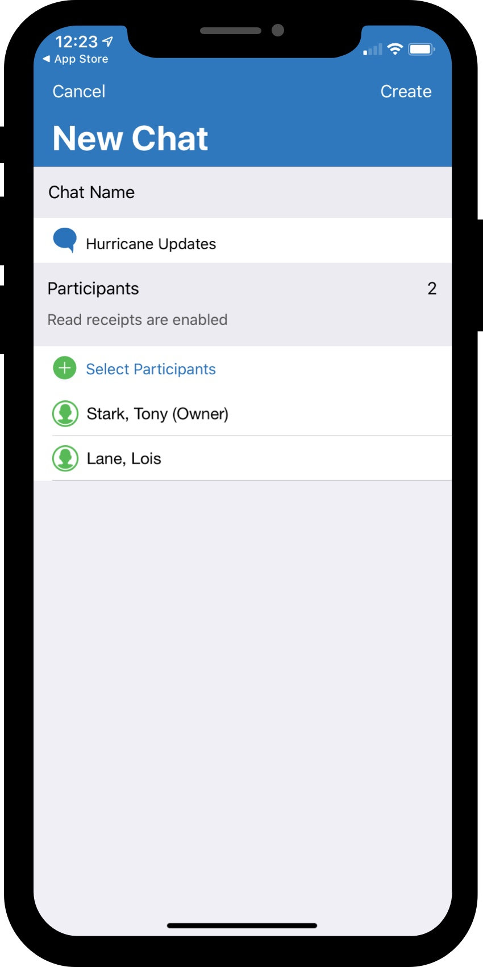
Secure Chat
Create a Secure
Select the size of the chat
  > 100 has read receipts enabled
Enter a Chat Name
Select Recipients
  Recipients can be added via groups or contacts, like an alert or poll

Slide 22
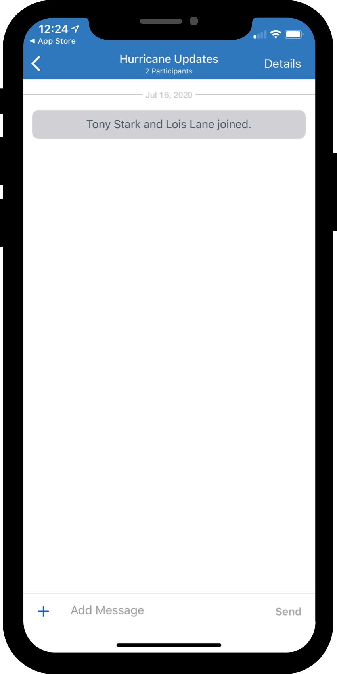
Secure Chat
Create a Secure
Confirm the details and tap Create in the top right corner
Start messaging
  By tapping the + icon users can share their location, images, and videos

Slide 23
Polls
Send a Poll
From the Drawer Menu, select Send Poll to start the Poll Creation process.

Slide 24
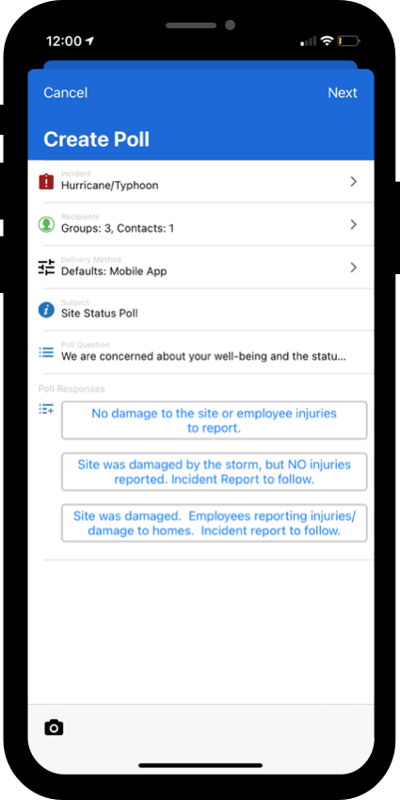
Polls: send
Select Incident, Recipients, Subject, Etc.
Similar to creating an alert, users will select an incident, recipients, subject, etc.
Where polls differ from alerts:
  Poll Question vs. Message
  Poll Responses

Slide 25
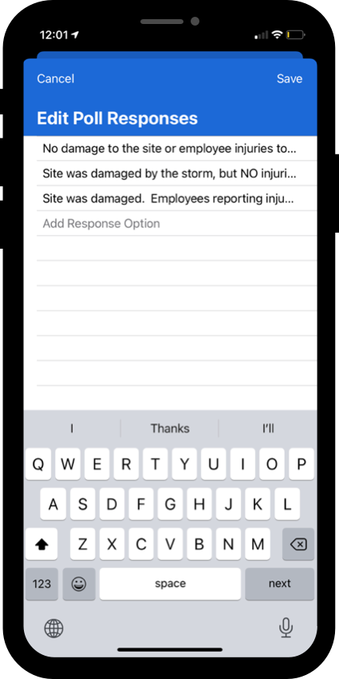
Polls:
Send
Question and Responses
To enter the poll question, tap on the Poll Question field to open the question editor. Questions can be input using the keyboard or dictated using the microphone.
To enter response options, tap Add Responses under the poll question field

Slide 26
Polls:
Send
Entering Responses
Polls can have between 2 and 5 responses
To enter a new response, tap Next on the keyboard
To save your responses, tap Save in the top left right corner of the screen
To send the poll, follow the same steps to as sending an alert
  Preview form
  Preview recipient view
  Tap send

Slide 27
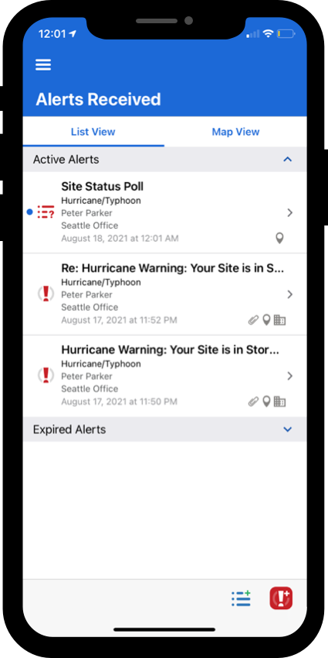
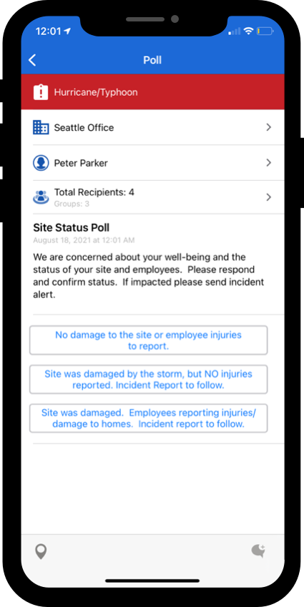
Polls:
Respond
Respond to a Poll
To respond to a poll, open the desired poll from Alerts Received
Select the option that best fits

Slide 28
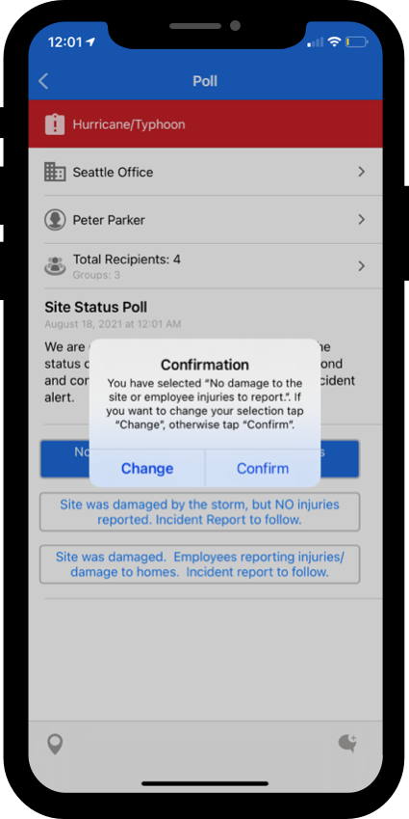
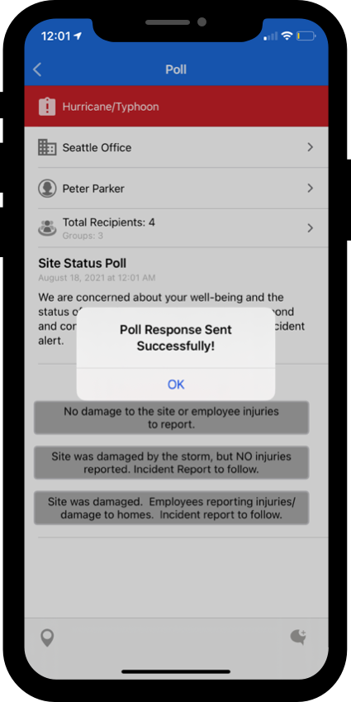
Polls:
Respond
Respond to a Poll
Confirm your response
  Only one response is allowed per user

Slide 29
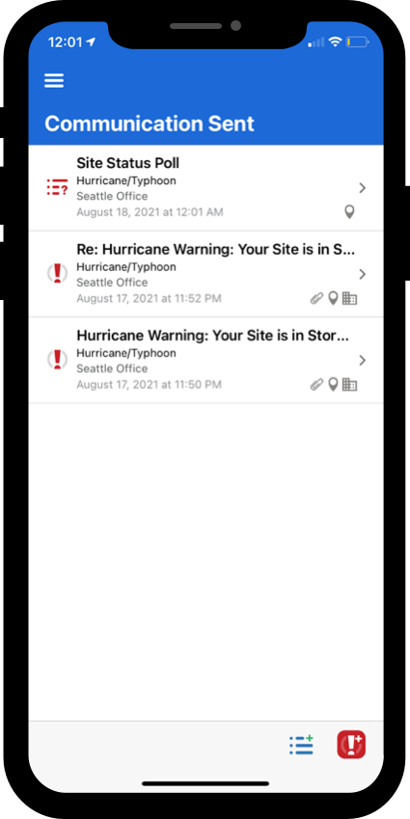
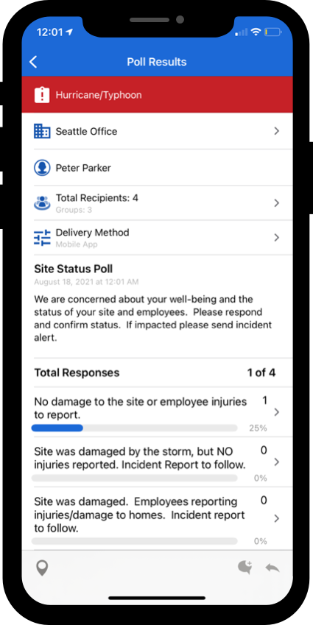
Polls: review
Review Results
To review results select the desired poll from Communication Sent.
  Poll senders can review the total count for each response option
  To view who responded to each option, tap the option to view more details

Slide 30
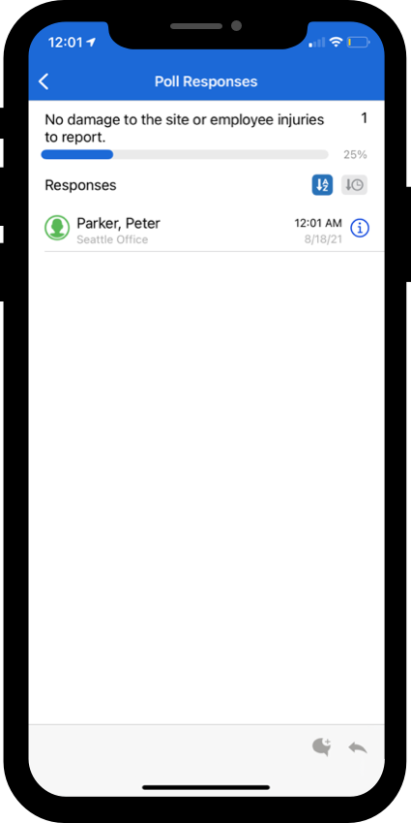
Polls: review
View Response Option Details and Communicate
To view who responded to each option, tap the option to view more details
Using the icons in the bottom toolbar, the poll sender can communicate with the different response groups either through secure chat or by creating an alert.

Slide 31
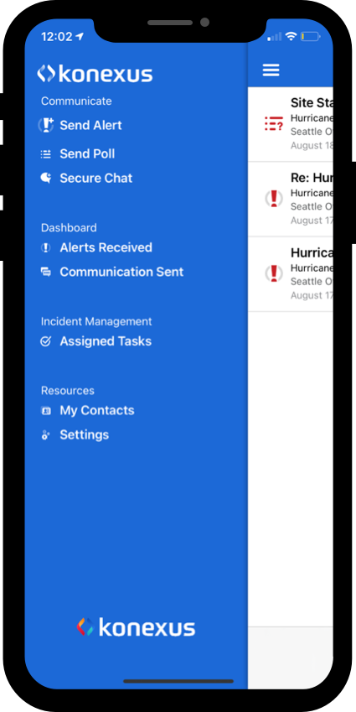
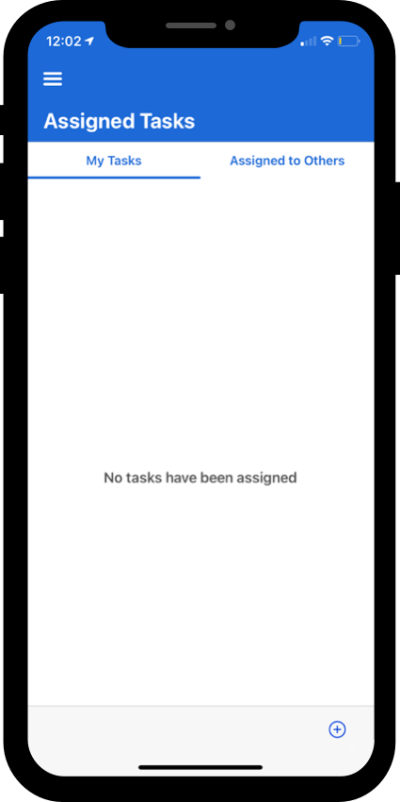
Assigned Tasks: activate
Activate a Task List Template
Go to Assigned Tasks from the drawer menu
From the bottom toolbar on the Assigned Tasks view click the + button

Slide 32
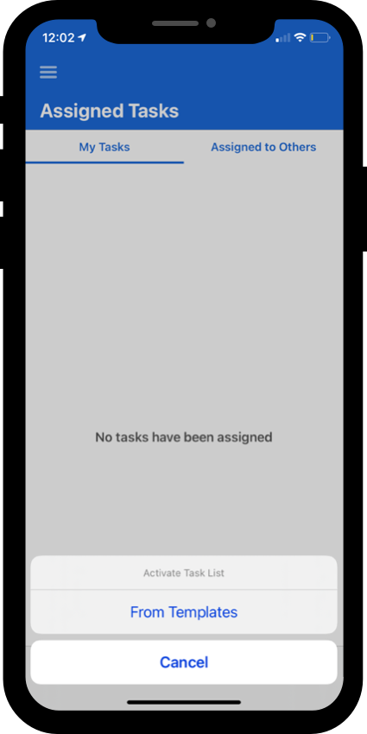
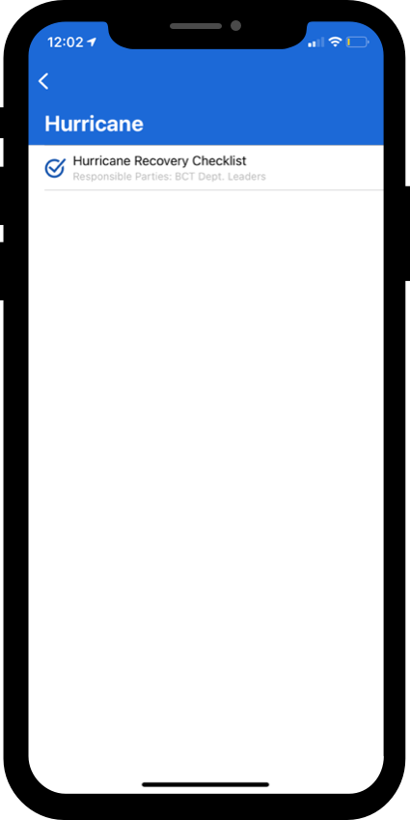
Assigned Tasks: activate
Activate a Task List Template
Click From Templates
Navigate the template structure and select the desired Task List template

Slide 33
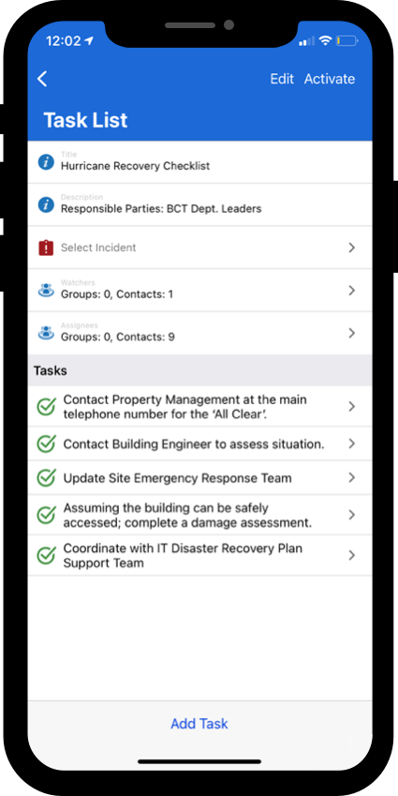
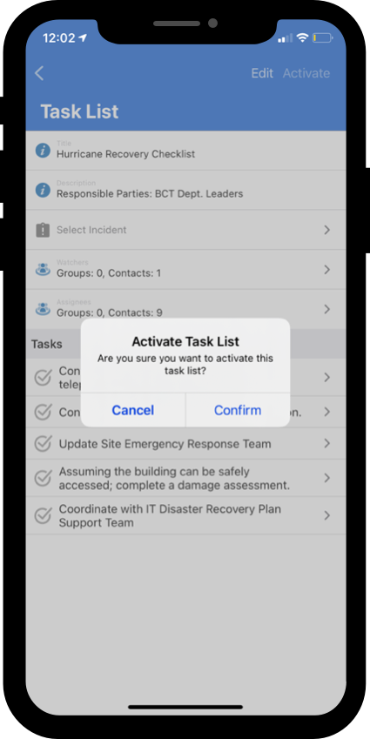
Assigned Tasks: activate
Activate a Task List Template
Review the template details and make any desired adjustments
  Users can modify the Task List prior to sending without any changes being made to the master template

Slide 34
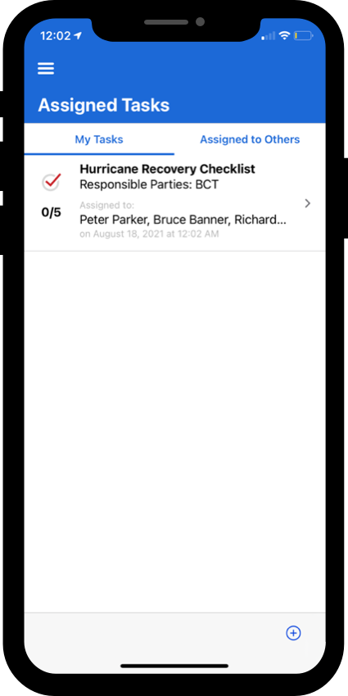
Assigned Tasks:
Complete
Compete an Activated Task List
Go to Assigned Tasks from the drawer menu
Select a Task List that has been assigned to you under the My Tasks tab

Slide 35
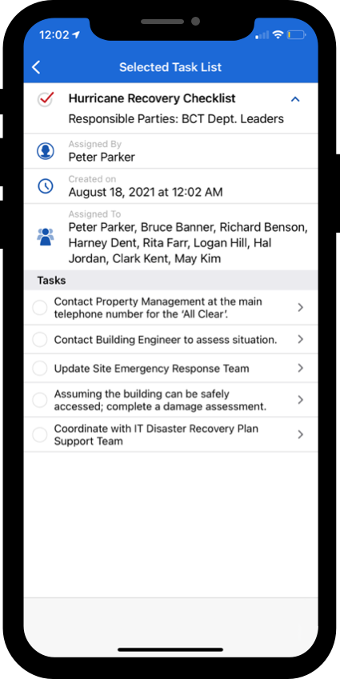
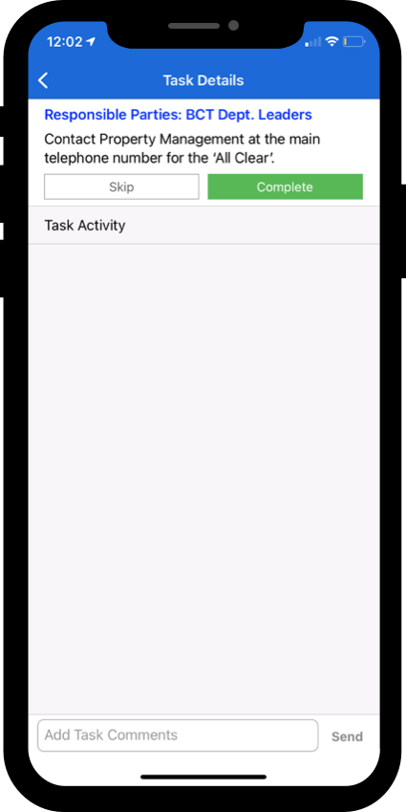
Assigned Tasks:
Complete
Compete an Activated Task List
From the Task List Details view select any of the tasks to take action
  Users can comment on, skip, or complete a task
Select a Task List that has been assigned to you under the My Tasks tab

Slide 36
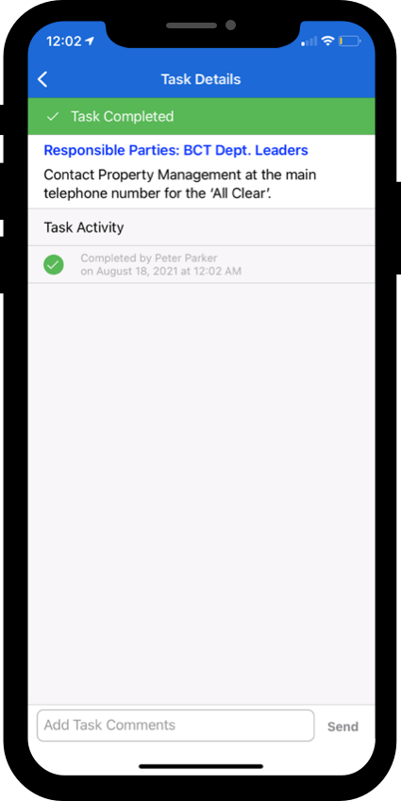
Assigned Tasks:
Complete
Compete an Activated Task List
Actions taken on an individual task are displayed on the Task Details view
Completing a Task cannot be undone

Slide 37
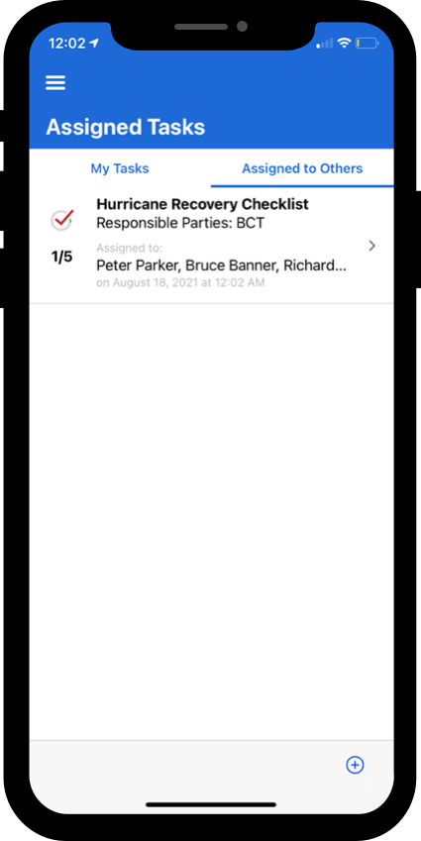
Assigned Tasks:
Monitor
Monitor an Activated Task List
Go to Assigned Tasks from the drawer menu
From the list view, the overall status of each activated Task List as well as additional details can be seen
Select a Task List from either Assigned to Others or My Tasks to view individual task details

Slide 38
Thank you

